Slide 1
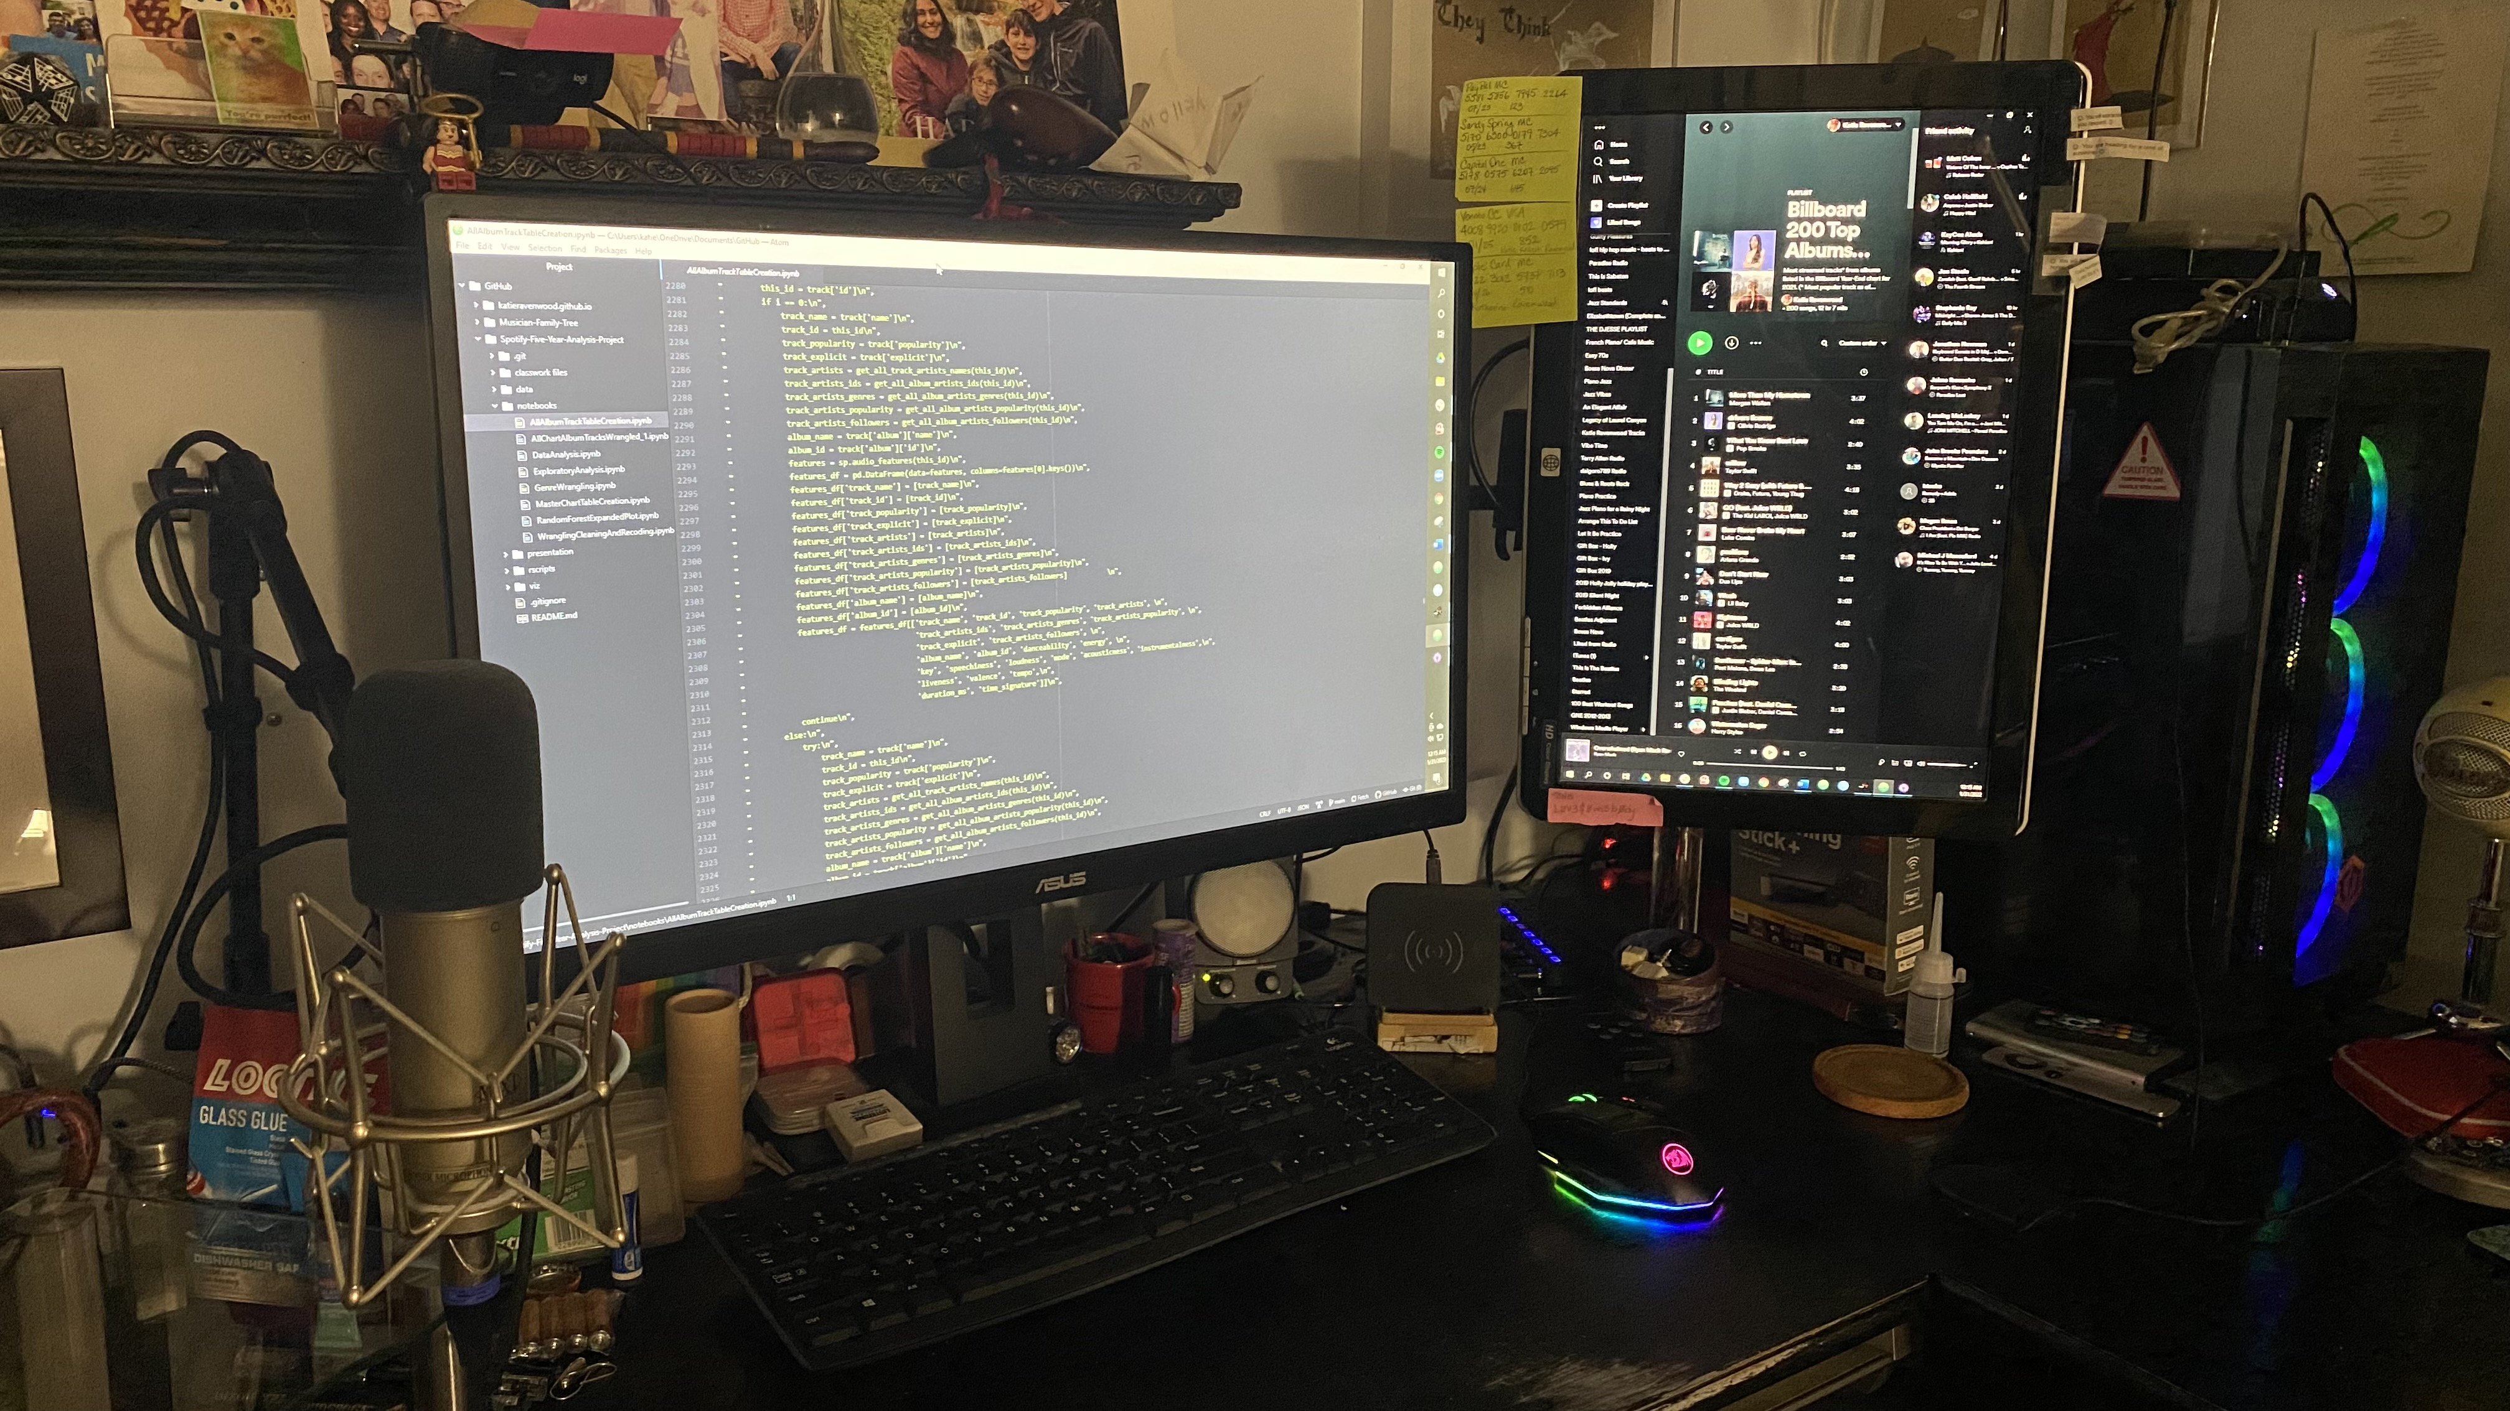
2017
2018
2019
2020
2021
https://bit.ly/SxB5YA
Good Vibrations?
Spotify x Billboard Top 200 Albums 5-Year Analysis Project
Bianca Serrano and Katie Ravenwood
Notes:
Bianca:

Slide 2

PRESENTERS
Notes:
Bianca:

Slide 3
PRESENTERS
BIANCA SERRANO
Educational background in psychology
Currently employed as a data coordinator for CUNY/NYSED
5+ years experience in database management
Skills in:
Data Wrangling
Data synthesis for monthly and annual reporting
Administration
Communication
Interested in music through a background in event music curation and active listening
Notes:
Bianca:

Slide 4
PRESENTERS
KATIE RAVENWOOD
Educational background in music & biochemistry
Currently employed as a musician & music teacher
25 years experience in music performance and music education
20 years experience in web development & marketing
Skills in:
Business administration and marketing
Contracting and contract negotiation
Front end design and development
Educational and curriculum design
Interest in music through a background in music performance and concert promotion
Notes:
Katie:

Slide 5

BACKGROUND

Slide 6
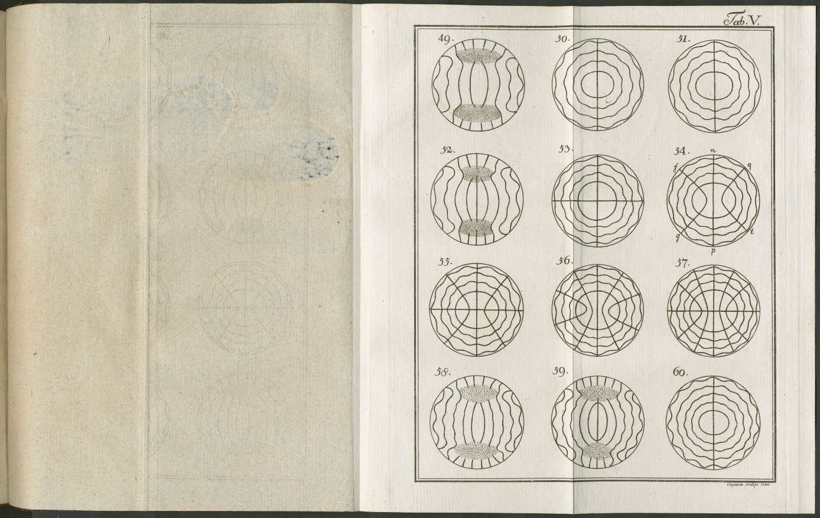
“If you want to find the secrets of the universe,
think in terms of energy, frequency and vibration.”
- Attributed to Nicola Tesla
Image: Ernst Cheladni’s nodal resonance figures from Discoveries in the Theory of Sound”, published in the late 18th Century.
Notes:
--There’s a famous quote attributed to Nicola Tesla that says “If you want to find the secrets of the universe,
think in terms of energy, frequency and vibration.”
-- For me, interest in this topic and in data science started when I discovered the Million Song Dataset, which is cluster of complementary datasets of audio features and metadata for a million contemporary popular music tracks up to about 2010.
-- We began this project with an interest in how peoples’ listening habits have changed over the past five years and particularly during the COVID-19 pandemic.

Slide 7

METHODS

Slide 8
OUR QUEST
CHANGES OVER TIME
Have there been any significant changes in music over the past five years?
Are there other significant features that change over time?
Do any of the features have similarities or contrasts?
GENRE PRESENCE
MOOD
Have there been any changes in genre presence on the charts? Which genres are changing and how?
Has mood of the most popular music changed over the past five years? How has it changed?

Slide 9
DATASET SELECTION
MUSIC DATA FOR ANALYSIS?
Available datasets were:
Too old
Wrong scope
Restricted access
Training datasets with errors

Slide 10


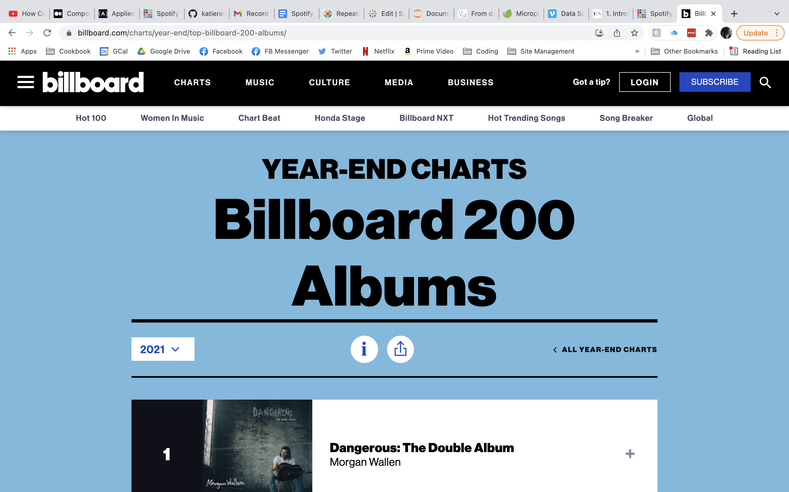
Billboard is an American music and entertainment magazine founded in 1894 in Cincinnati, Ohio and now operating in several countries around the world.
Billboard is best known for its weekly charts, including the Billboard 200 albums ranking and the Hot 100 singles chart, as well as its yearly 200 Albums chart.
The Top 200 Album chart lists the year's most popular albums across all genres, ranked by physical and digital album and track sales as well as audio on-demand streaming activity.
Billboard charts are powered by information from MRC Data (formerly Nielsen Music or Nielsen Soundscan.)
Source: “Billboard”. Music Business Worldwide, 31 January 2022. https://www.musicbusinessworldwide.com/companies/billboard/

Slide 11


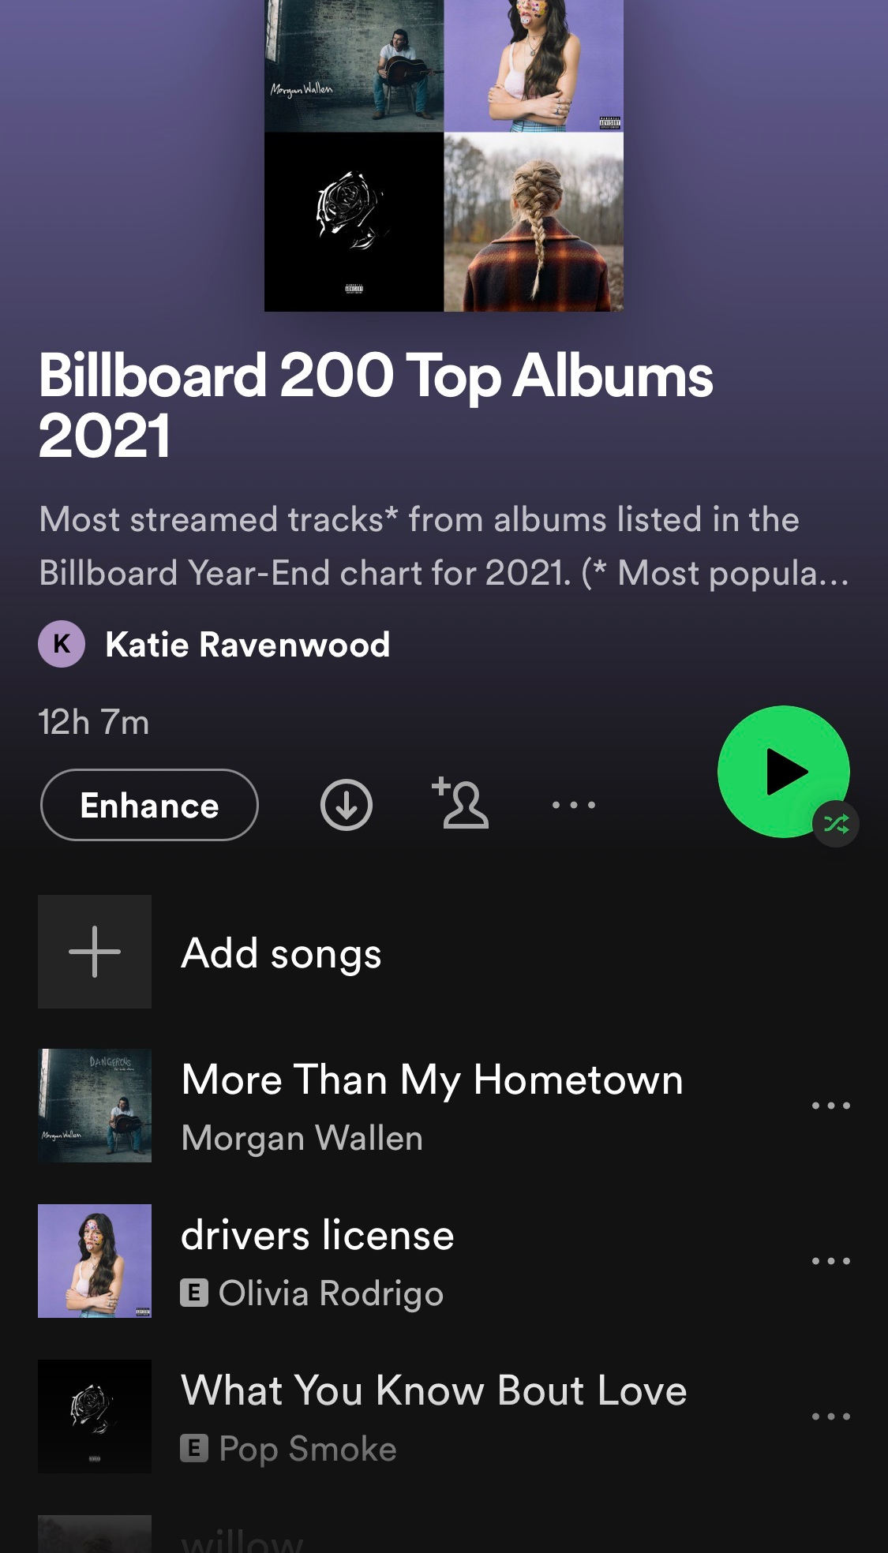
HISTORY
Spotify was founded in 2006 in Stockholm, Sweden, by Daniel Ek and Martin Lorentzon.
USERS
365 million people use Spotify at least once a month, and 165 million are paid subscribers.
CATALOG
More than 70 million songs are available on Spotify, and the company has reported that more than 60,000 new tracks are now uploaded to Spotify every day.
API
Data is available to developers through Spotify’s API, and includes information about artists, albums, and tracks as well as user data on song popularity and streaming statistics.
Source: “Spotify Revenue & Usage Statistics.” Business of Apps, 19 January 2022, https://www.businessofapps.com/data/spotify-statistics/

Slide 12

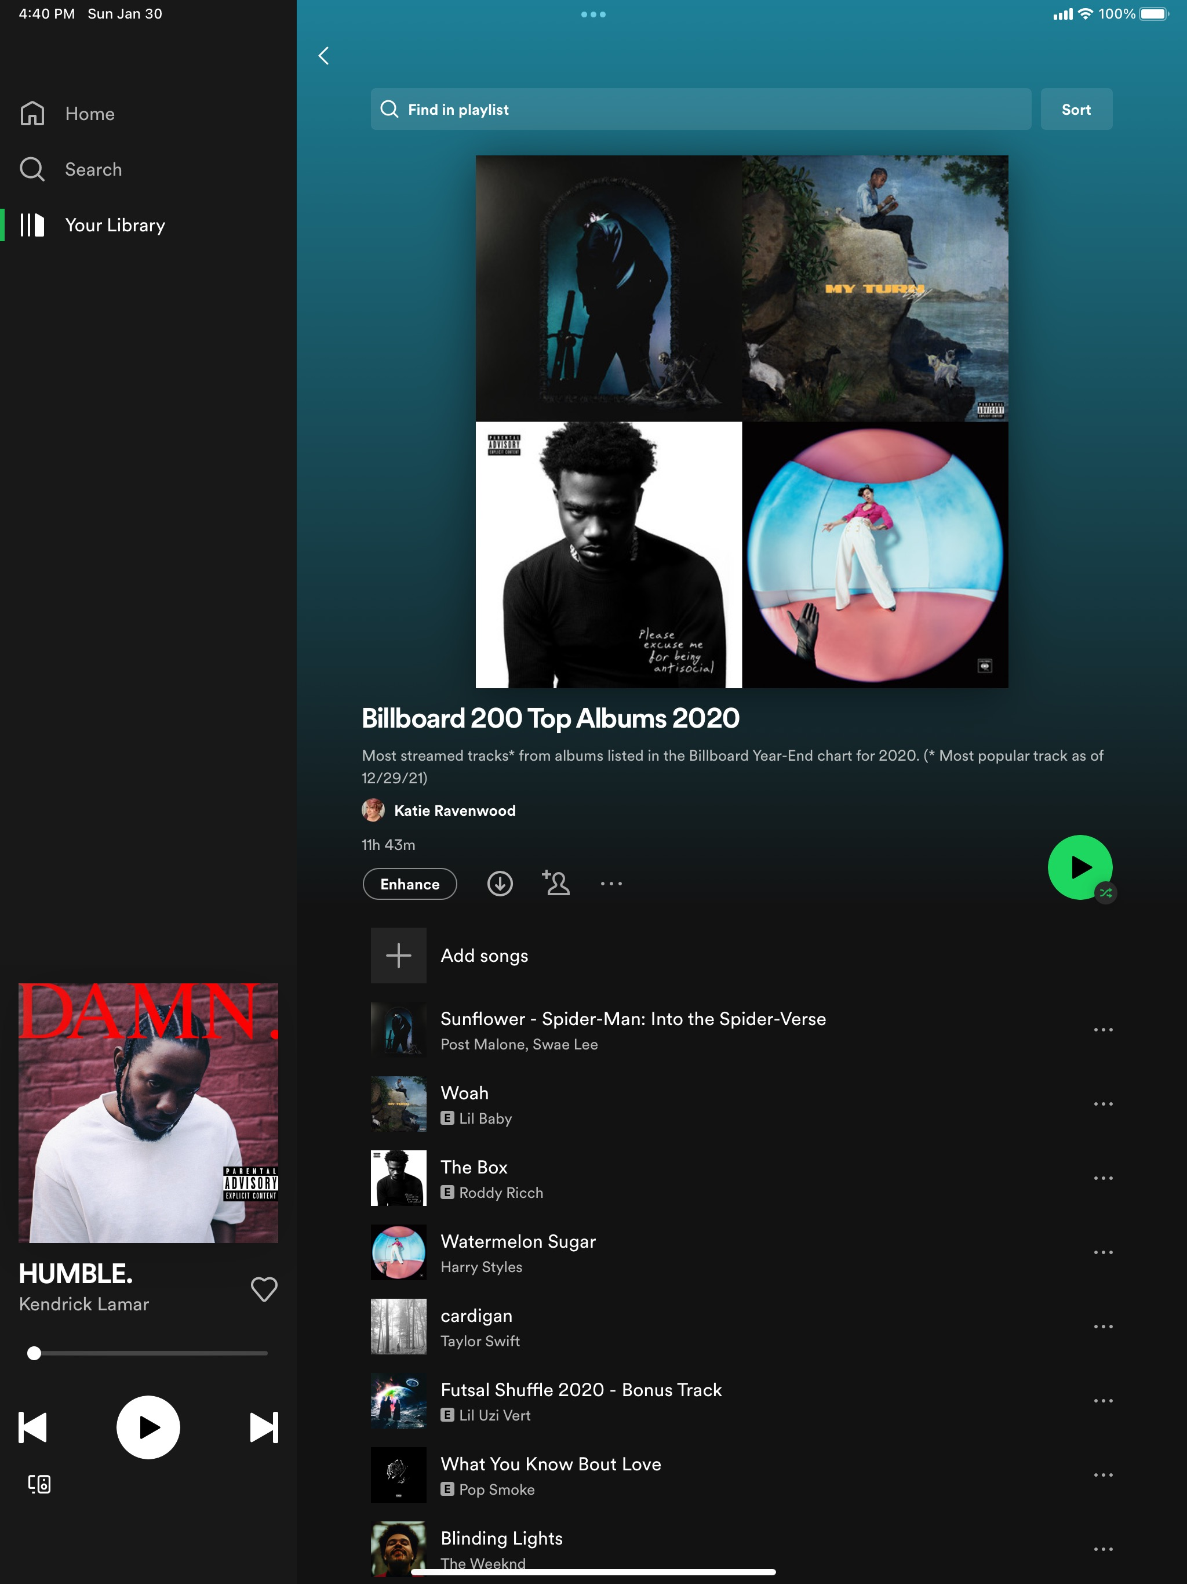
SPOTIFY API
SPOTIFY DEVELOPER PLATFORM
Playlists of each
chart were created in Spotify to provide endpoints for accessing chart data.
The Spotify Developer Platform provides access to calculated audio features of tracks such as danceability, energy, valence, and more. For more advanced use cases, it is possible to read in-depth analysis data about tracks such as the segments, tatums, bars, beats, pitches, and more.
Spotify Web API endpoints return JSON metadata about music artists, albums, and tracks, directly from the Spotify Data Catalogue.
SPOTIFY PLAYLISTS
01.
Billboard 200 Top Albums 2017
02.
Billboard 200 Top Albums 2018
03.
Billboard 200 Top Albums 2019
04.
Billboard 200 Top Albums 2020
05.
Billboard 200 Top Albums 2021

Slide 13
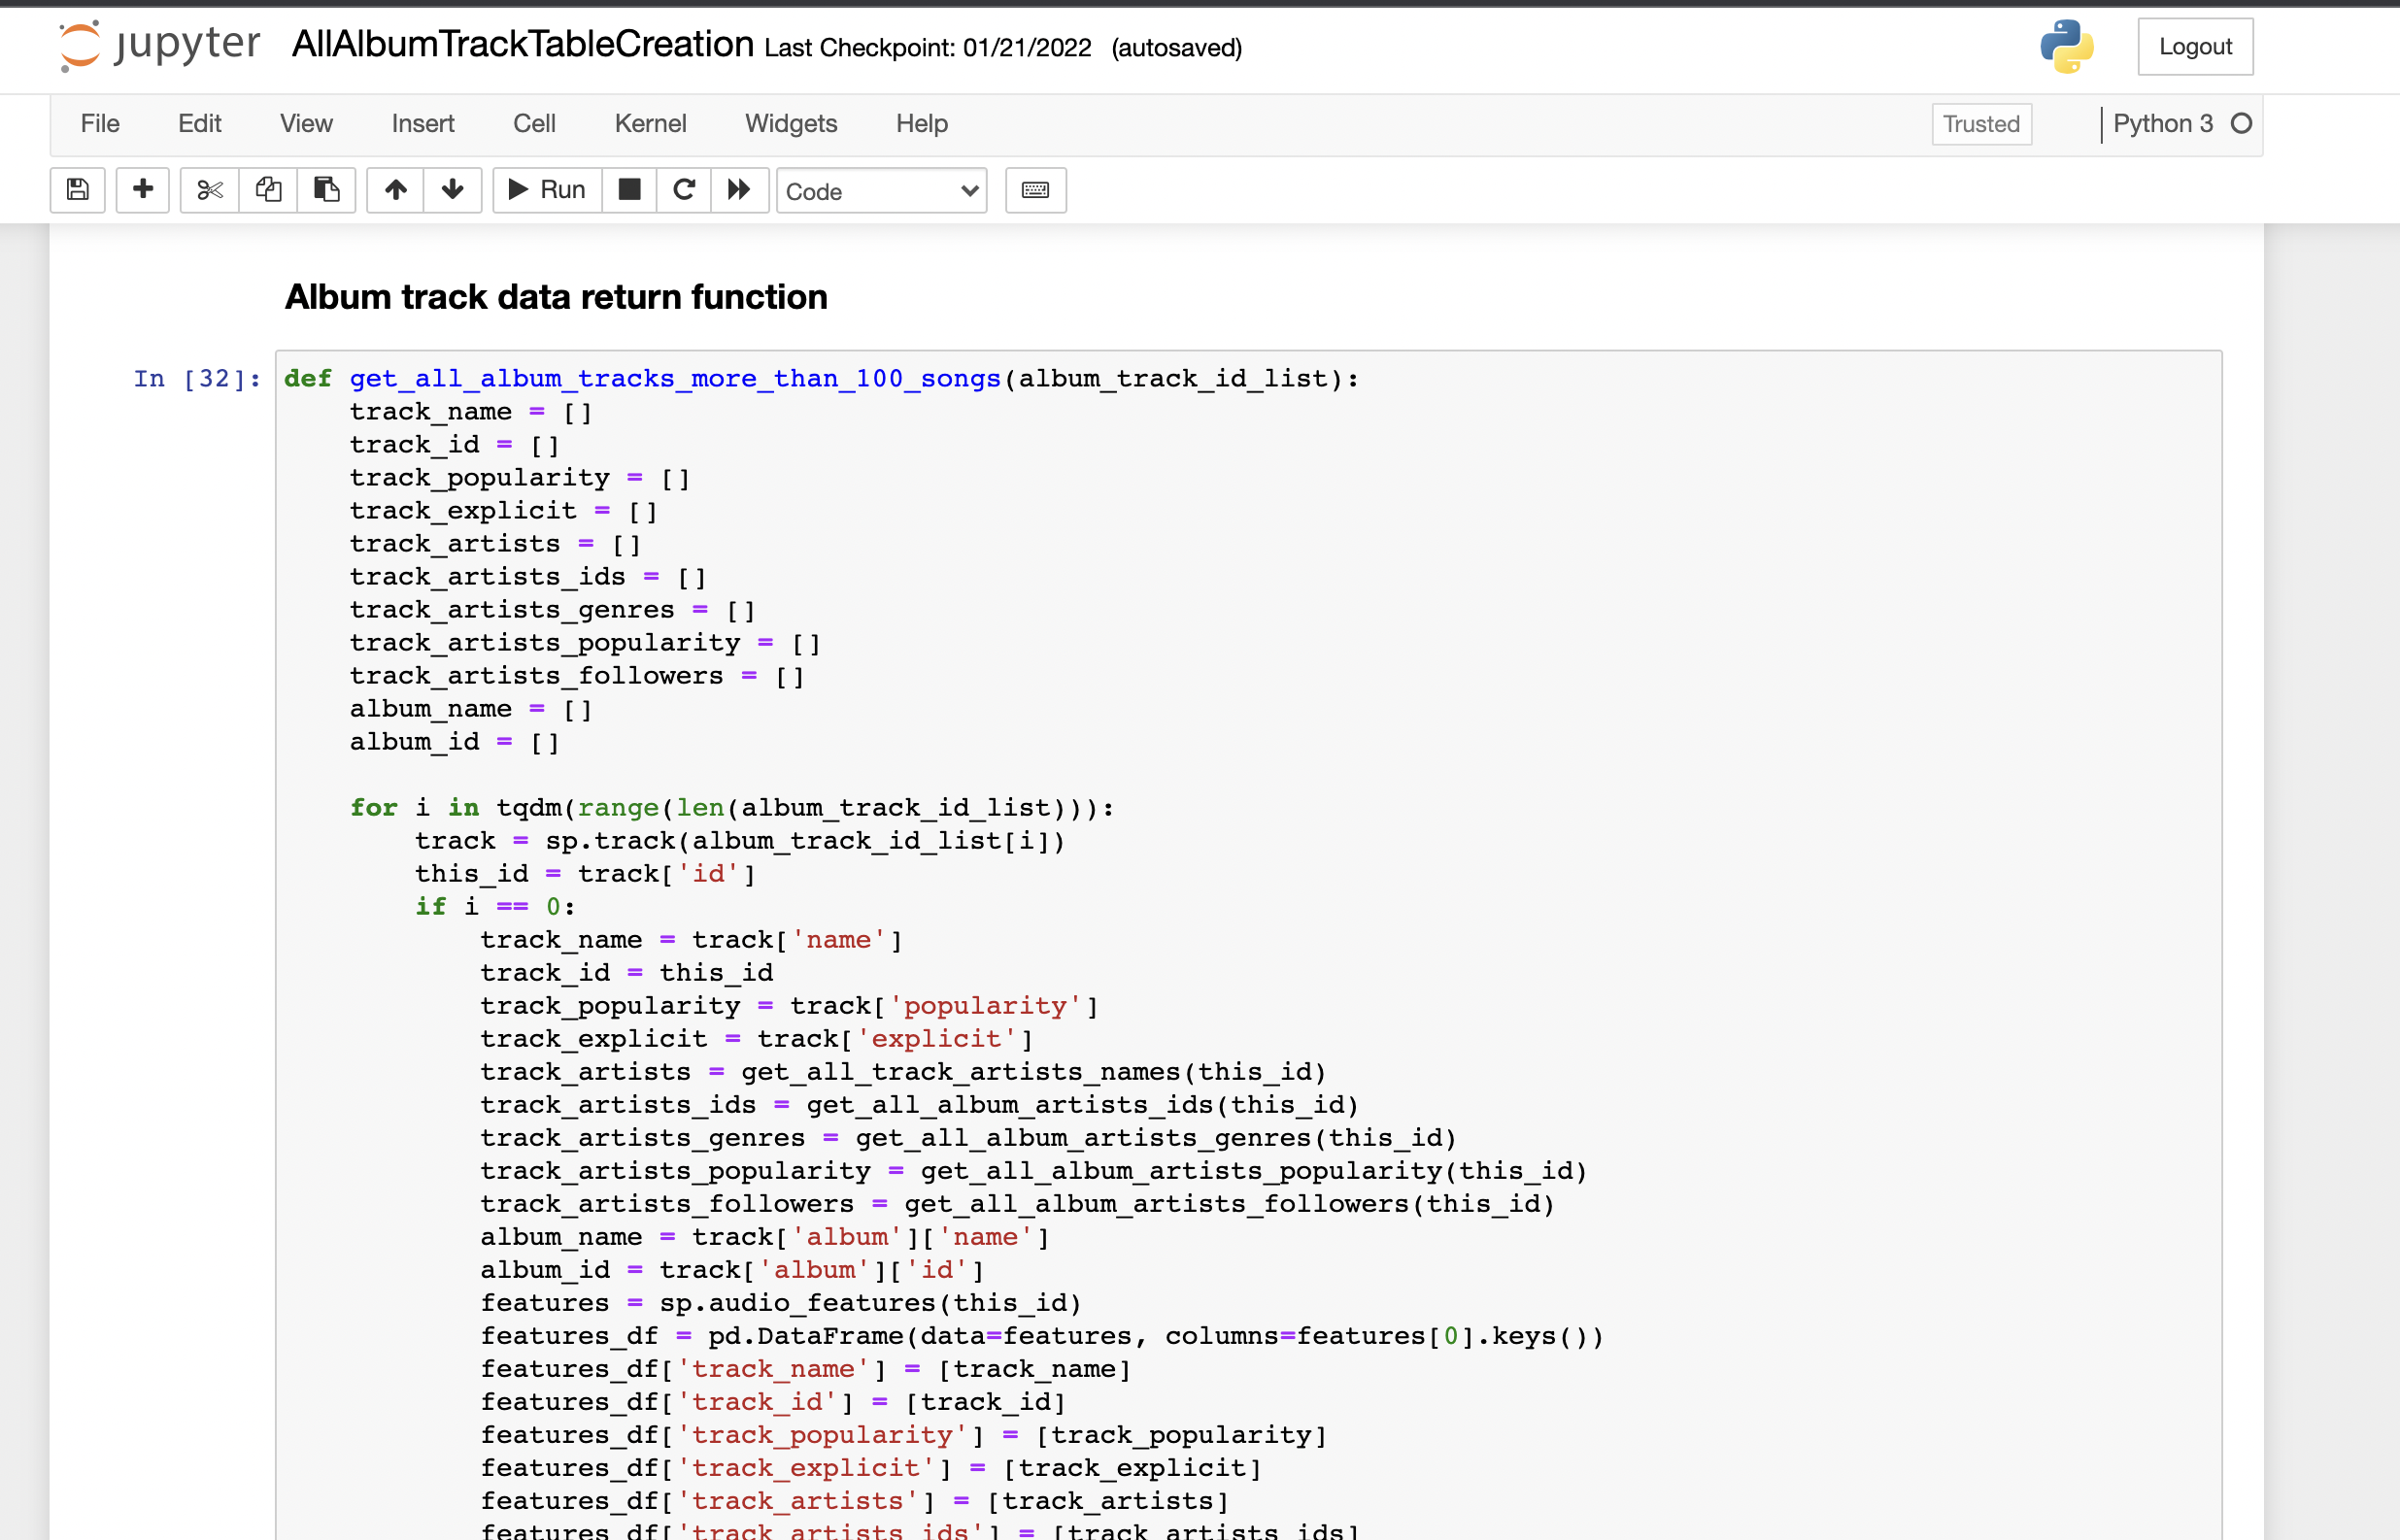
DATASET CREATION
PYTHON & SPOTIPY
8996 TRACKS FROM 560 ALBUMS
Data tables of album and track information were created with Python using the SpotiPy package.
Included variables:
Billboard album chart name & year
Album ID, name, release year
Album artists' names, IDs, popularity, and associated genres
Track IDs, popularity, and statistics
Explicit labeling designation
Audio features
Notes:
To create the dataset, we used the SpotiPy package for Python, which offers efficient communication with the Spotify API and access to the JSON endpoints in Spotify’s Data Catalogue.
Each playlist featured information for 200 albums, some of which were repeated over the yearly charts. In order to pull all of the data we had to create a script to work with and around Spotify’s rate limits which capped returned data to 100 tracks at a time, so we designed a function that allowed timing and pull requests to be paced to communicate steadily with the API while returning all of the necessary information. The code for this can be seen in our GitHub repo for the project.
The script allowed us to pull data from 8996 tracks from 560 albums into a single data table.

Slide 14





DATA WRANGLING
JOINS
FEATURES
TRACK & ALBUM
TABLES
CLEANING &
DUMMY CODING
Multiple joins for various charts and analyses
Removing null values and dummy coding genres for analysis
GENRES
DATES
UN-NESTING LISTS
RECODING TO DATETIME
Wrangling nested lists of genres linked by artist
Recoding release dates and chart years to datetime format
Notes:
K:
We joined the track and album tables to reflect the presence of albums on multiple charts and cleaned the data by removing null values. Information about chart years and album release dates was recoded to datetime format.
Spotify features more than 5000 genre designations, and associates genres with artists rather than tracks, which creates nested lists of information when pulled from the API. In order to properly analyze the data we pulled those genres out of the nested list and then recoded the one-hundred and eighty nine genres present in our dataframe down to 18 umbrella genres.
B: (recoding variables in R)

Slide 15

RESULTS

Slide 16
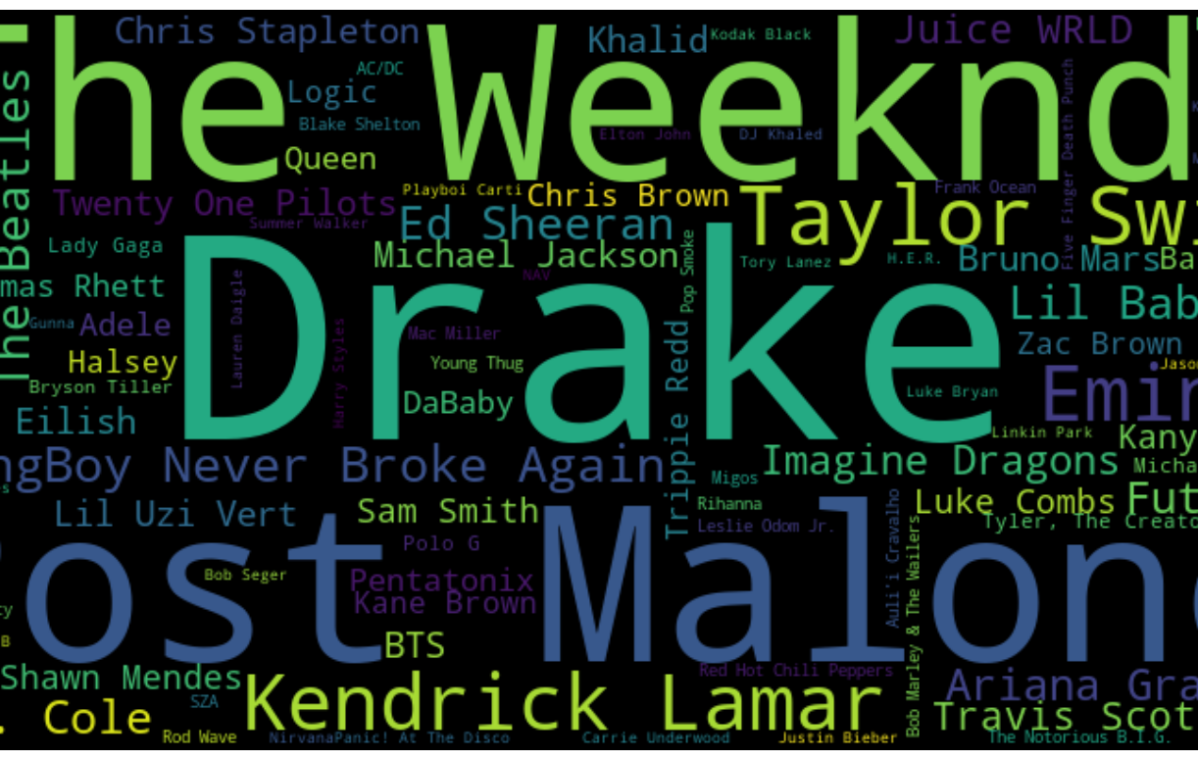
Interesting Data Points
Shape of the tracks dataframe: 16,501 rows and 57 variables
Most popular song: ”good for you” by Olivia Rodrigo and “Woman” by Doja Cat
Average song length: 3 minutes and 22 seconds
Longest song: “Like I Never Left” by Future at 25 minutes 33 seconds
Most frequently appearing album artist: Drake (31 times)
Appearances by Taylor Swift (15), Queen (7), and Elton John (4)
Oldest track: “The Christmas Song (Merry Christmas To You)” released in 1962
Newest track: “Bad Morning” by Young Boy Never Broke Again released on October 5, 2021.
Notes:
B: Read slide

Slide 17
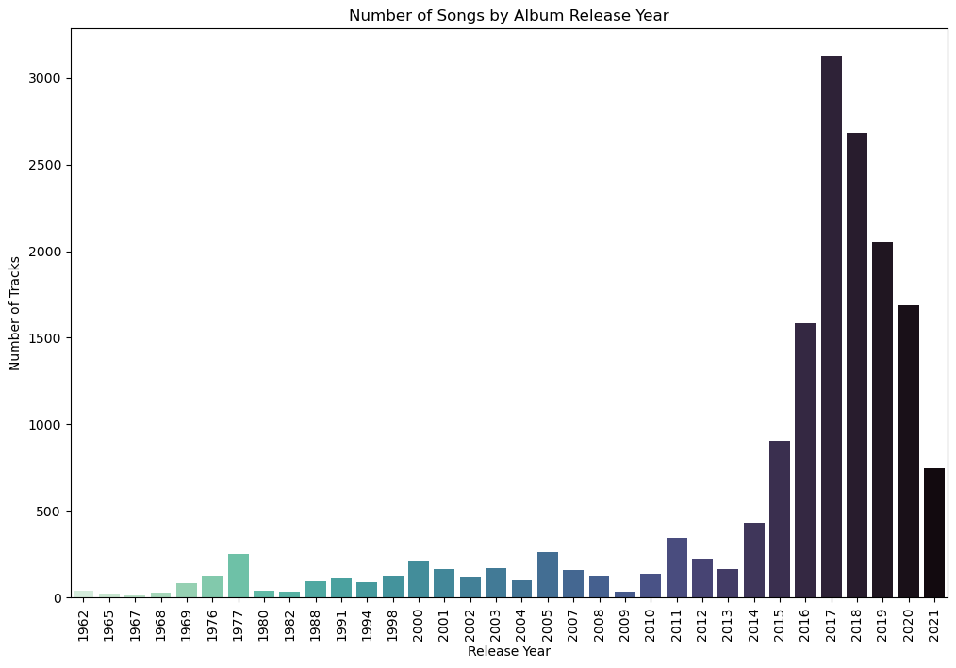
NUMBER OF TRACKS BY RELEASE YEAR
Notes:
K : Most of the tracks in our dataset were released fairly recently, but the dataset includes releases going all the way back to 1962.

Slide 18
AUDIO FEATURES
SPEECHINESS (0 -> 1)
Detects the presence of spoken words in a track. Closer to 1 means higher spoken word presence.
ACOUSTICNESS (0 -> 1)
KEY (-1 to 11)
TEMPO (BPM)
A confidence measure of how likely it is that the track is performed acoustically (as opposed to amplified.)
The key the track is in. Integers map to pitches using standard Pitch Class notation.
Beats-per-minute measure of the speed or pace of a track derived from beat duration.
DANCEABILITY (0 -> 1)
LIVENESS (0 -> 1)
TIME SIGNATURE (3 to 7)
How suitable a track is for dancing based on elements including tempo and beat strength and overall regularity.
Detects the presence of an audience in the recording. Greater than 0.8 is likely recorded live.
Specifies how many beats in each measure or bar of music.
ENERGY (0 -> 1)
LOUDNESS (-60 to 0)
VALENCE (0 -> 1)
Measures intensity and activity in a track, influenced by dynamics, loudness, timbre, onset rate, and general entropy.
Average loudness of a track’s normalization level in decibels across the entre track.
Measures the musical positiveness of a track. Higher values equal more cheerfulness.
INSTRUMENTALNESS (0 -> 1)
MODE (1 or 0)
EXPLICIT (T/F)
Confidence measure that predicts whether a track contains no vocals (oohs and aahs are considered non-vocal sounds.)
Indicates whether a track is in major (1) or minor (0) mode.
Indicates whether the track has been marked for Parental Advisory labelling. False indicates not marked or no information given.

Slide 19
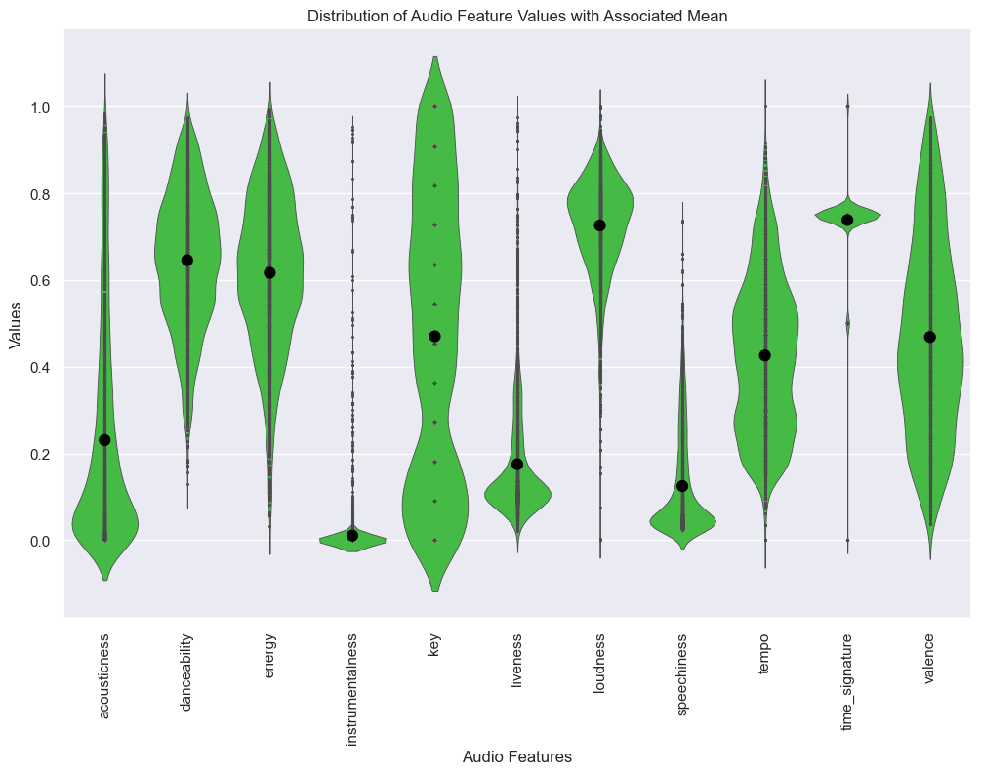
DISTRIBUTION OF AUDIO FEATURE VALUES
Notes:
This violin plot show the distribution of the audio features values across the dataset, with their associated means represented by the dots. This plot allows you to see where the highest concentrations of values lie along the range of values and is a result of standardizing the variables to the same scale for easier visualization.

Slide 20
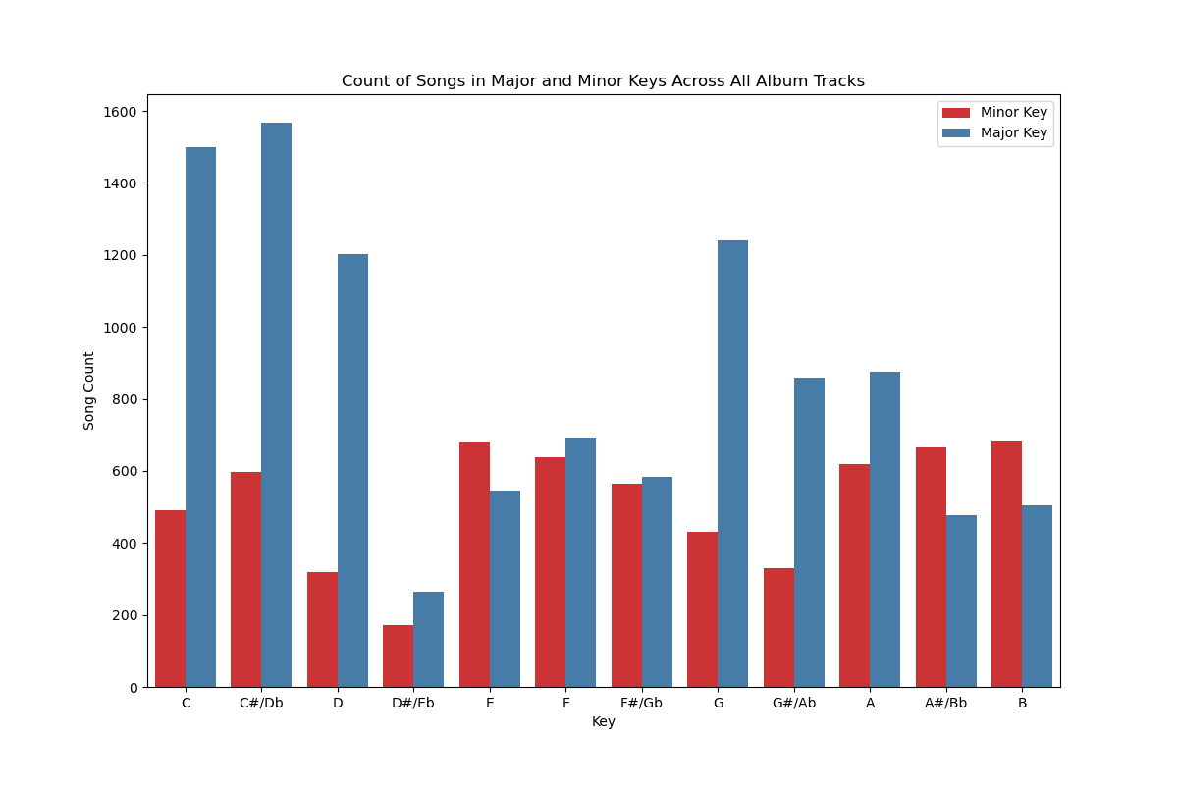
TRACK COUNT BY MAJOR & MINOR KEY
Notes:
We were interested in which keys were most popular across the dataset, and I found it interesting that of course there are more tracks in the keys that musicians find it easiest to play in. These also largely correspond with the open chords on guitars as well.

Slide 21
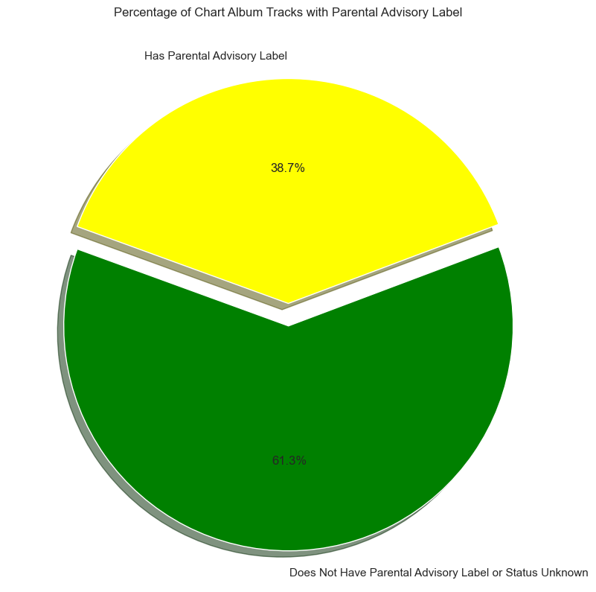
PARENTAL ADVISORY LABELING
Result of Parents Music
Resource Center (PMRC)
Congressional Hearings in 1985
Labels are voluntarily applied
by record labels or artists
Album-wide labeling
No set standard for labeling
Labeling assessment inconsistent
Missing data: non explicit,
non-labeled & unknown status
Source: “Parental Advisory Label – RIAA”. RIAA, 13 January 2022,
https://www.riaa.com/resources-learning/parental-advisory-label/

Slide 22
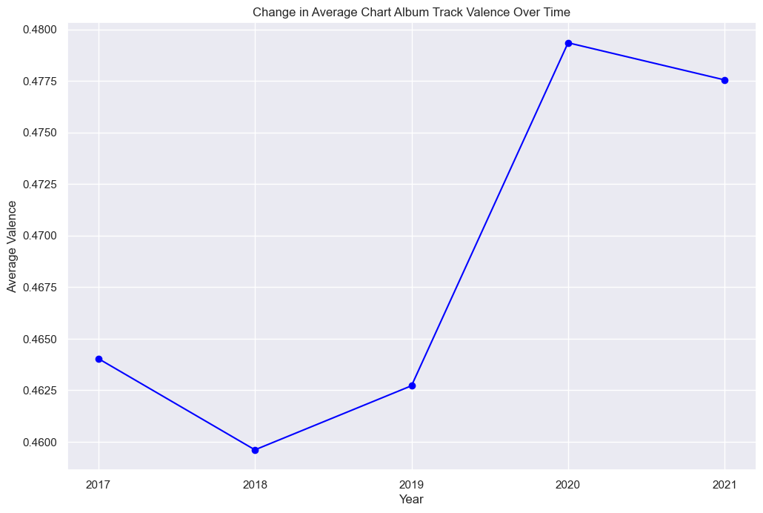
CHANGE IN VALENCE OVER TIME
Notes:
B:

Slide 23
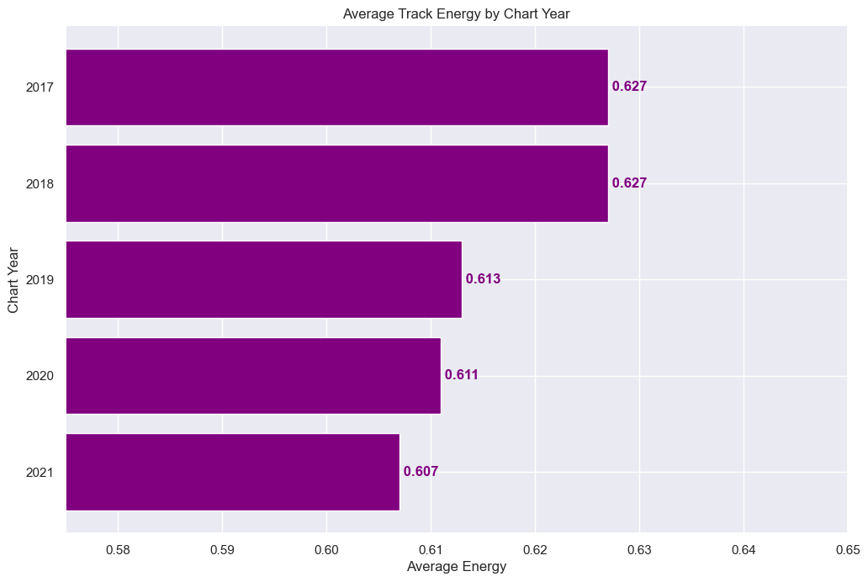
ENERGY

Slide 24
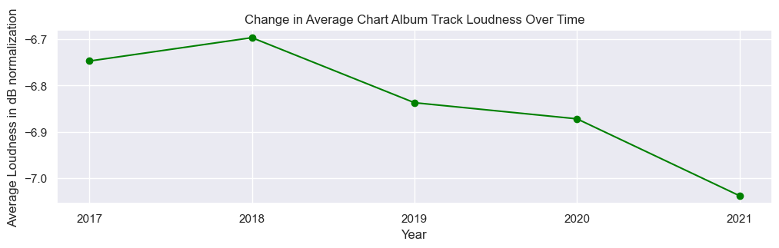
CHANGE IN LOUDNESS OVER TIME
-6.75 dB
-6.70 dB
-6.84 dB
-6.87 dB
-7.04 dB
2017
2018
2019
2020
2021
Notes:
B:

Slide 25
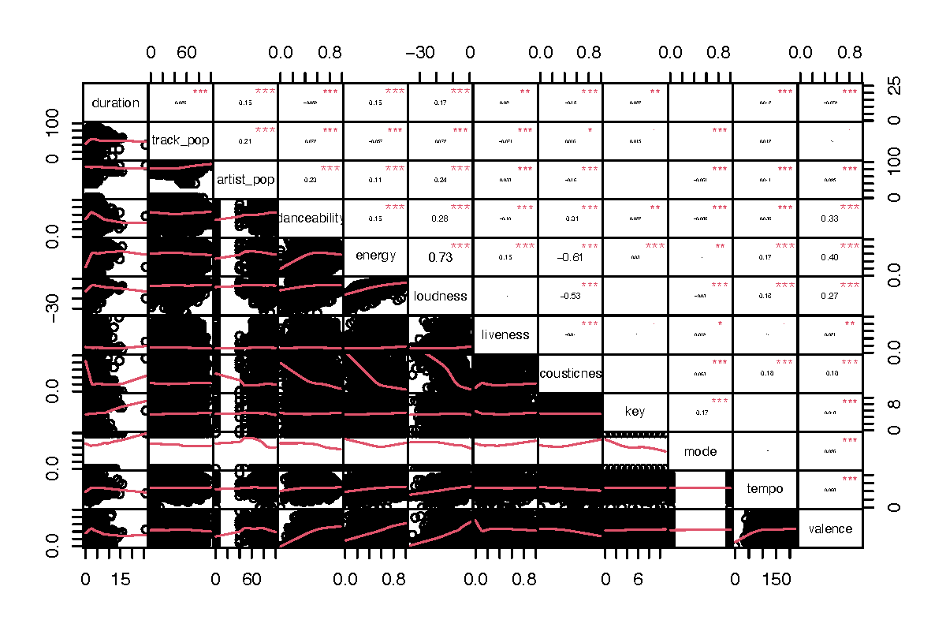
CORRELATION MATRIX OF FEATURES
Notes:
B:

Slide 26
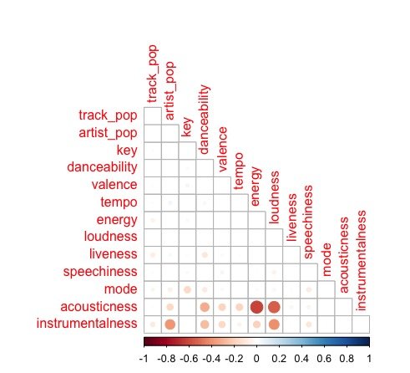
CORRELATION PLOT OF
FEATURES

Slide 27
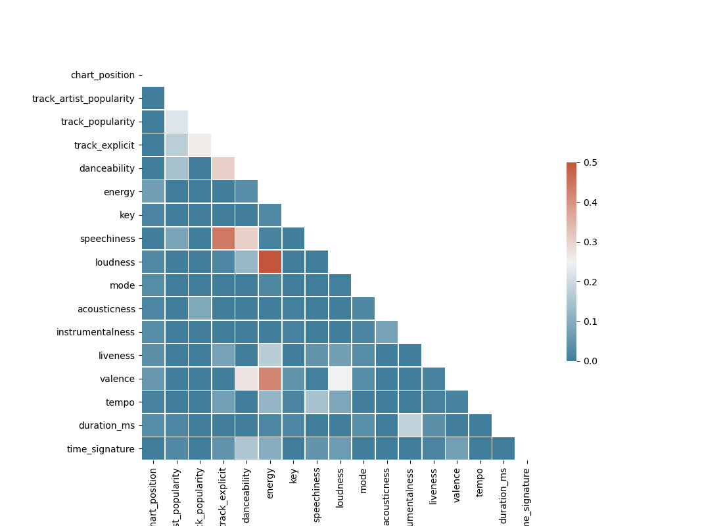
CORRELATION HEAT MAP OF FEATURES

Slide 28
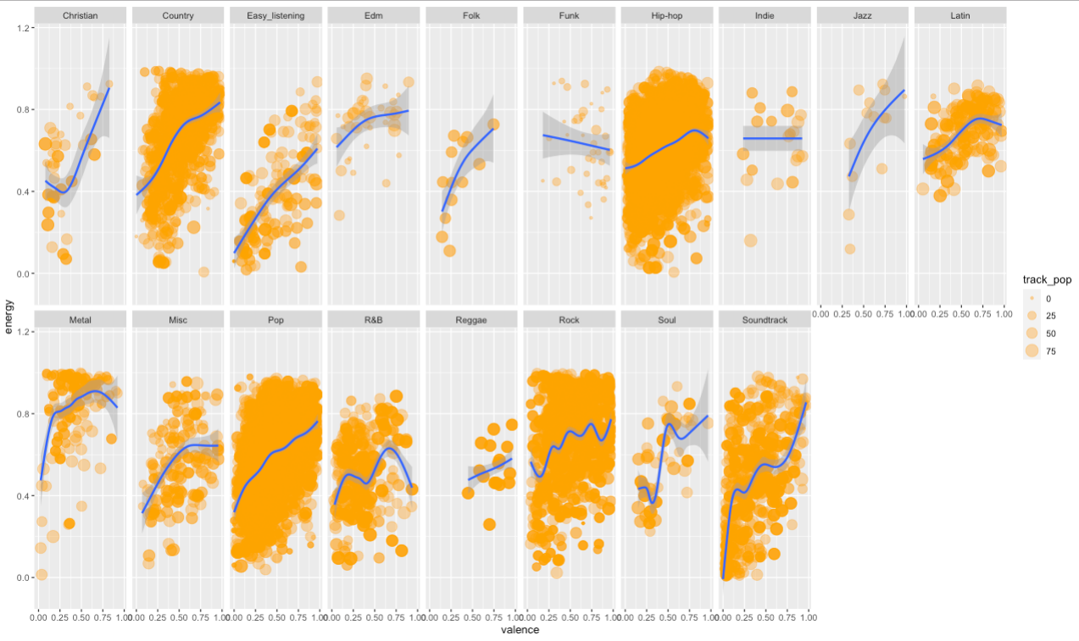
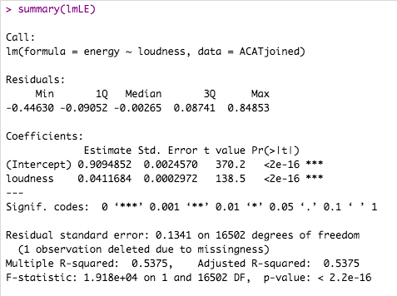
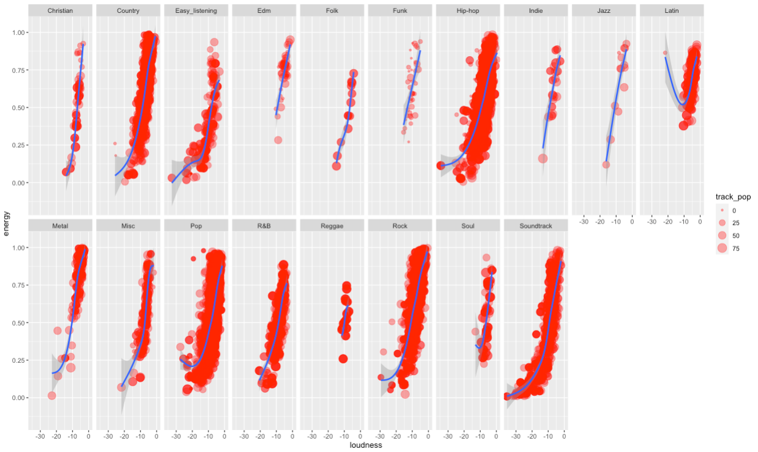
FACET PLOTS
LOUDNESS & ENERGY
SIZED BY TRACK POPULARITY
WRAPED IN GENRE
VALENCE & ENERGY
SIZED BY TRACK POPULARITY
WRAPPED BY GENRE

Slide 29
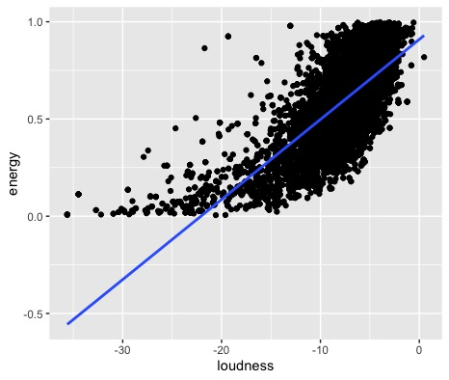
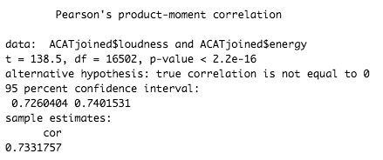
CORRELATION BETWEEN ENERGY & LOUDNESS

Slide 30
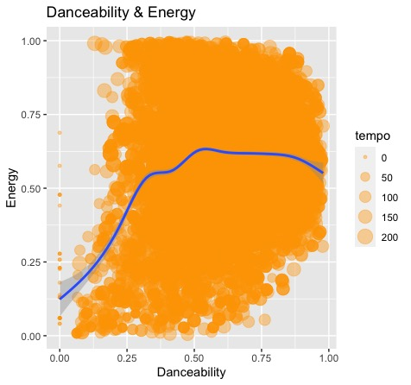
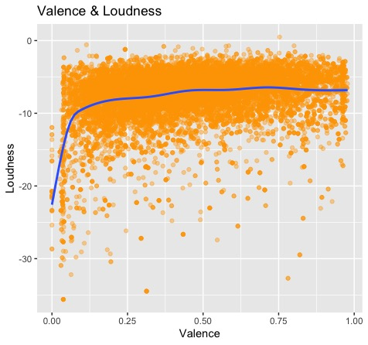
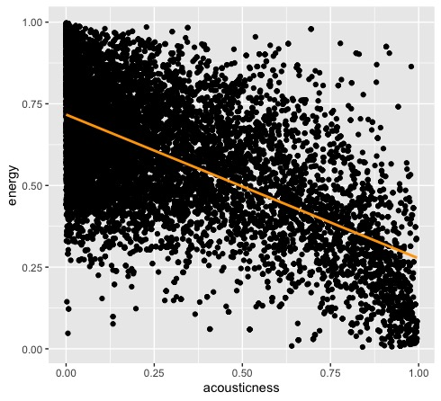
CORRELATIONS
Acousticness &
Energy

Slide 31
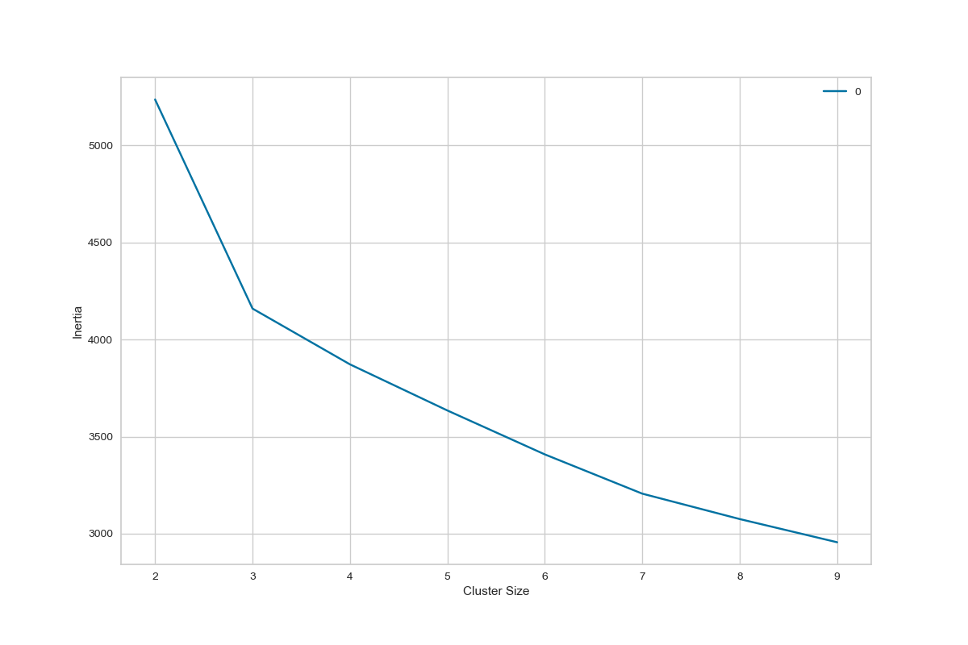
K-MEANS CLUSTERING
IDEAL NUMBER of CLUSTERS: 3

Slide 32
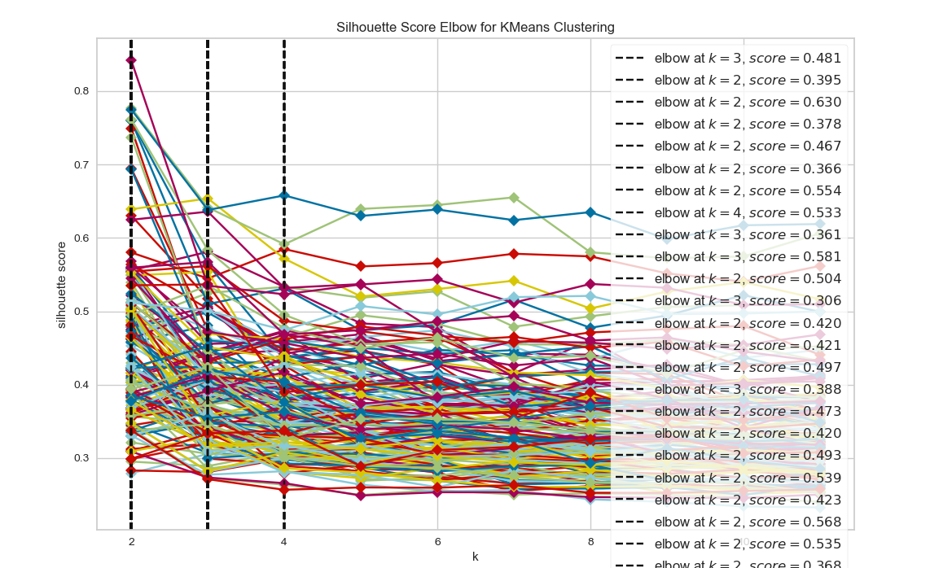
POSSIBLE FEATURE COMBINATIONS

Slide 33
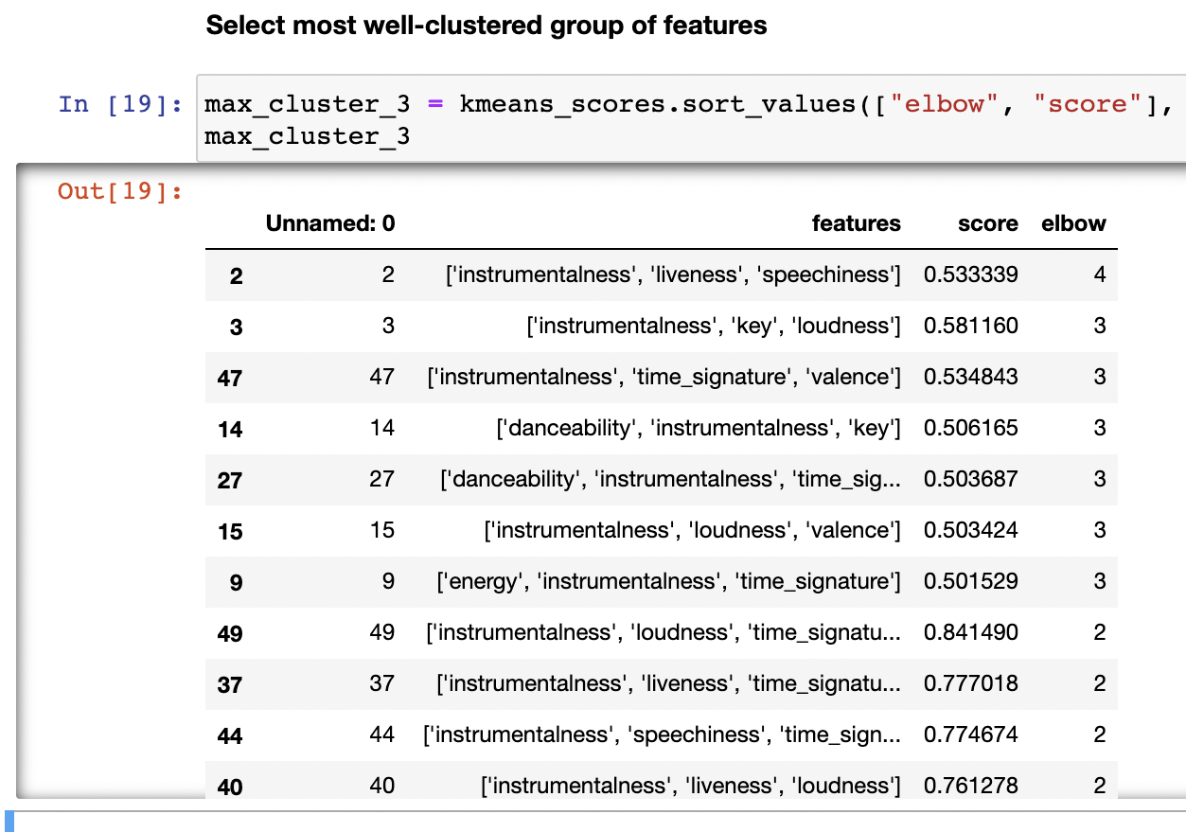
CLUSTERING SCORES
BEST CLUSTER GROUP OF 3:
INSTRUMENTALNESS
LIVENESS
SPEECHINESS
0.53339

Slide 34
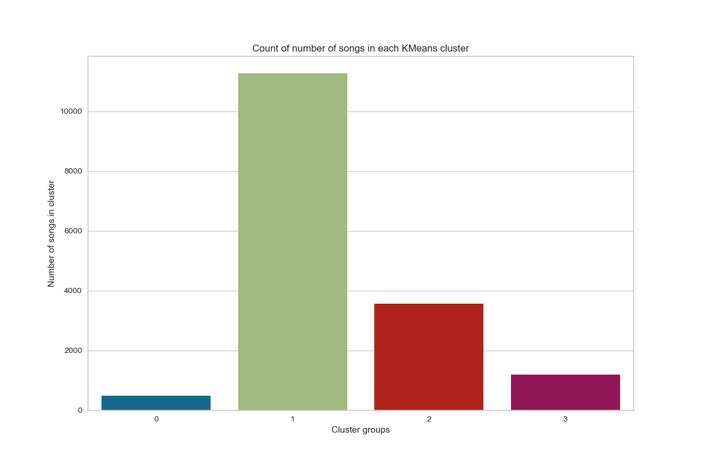
CLUSTERED TRACK GROUPS

Slide 35
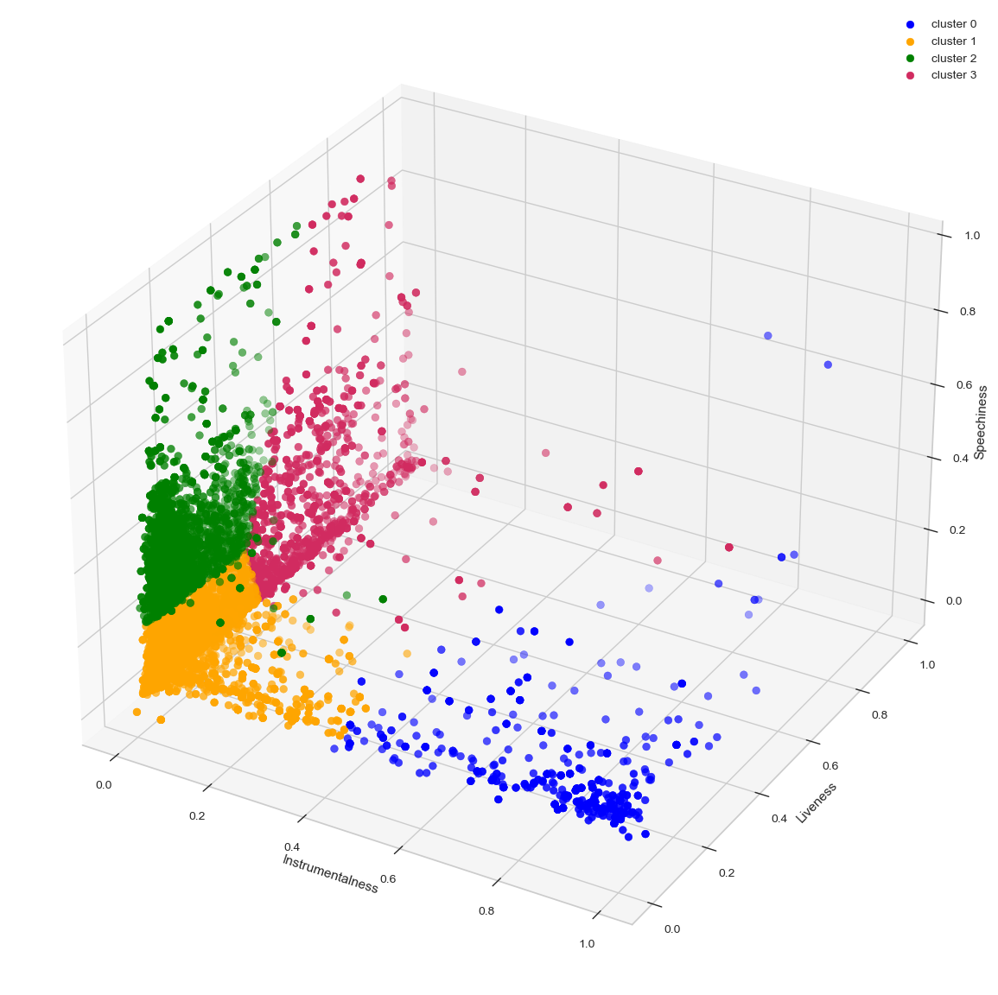
KMEANS CLUSTERS
1st Cluster:
Mid-high instrumentalness
Low-mid liveness
Low-mid speechiness
2nd Cluster:
Low-mid instrumentalness
Low-mid liveness
Low-mid speechiness
3rd Cluster:
Low instrumentalness
Low-mid liveness
Mid-high speechiness
4th Cluster:
Low instrumentalness
Mid-high liveness
Low-mid speechiness

Slide 36
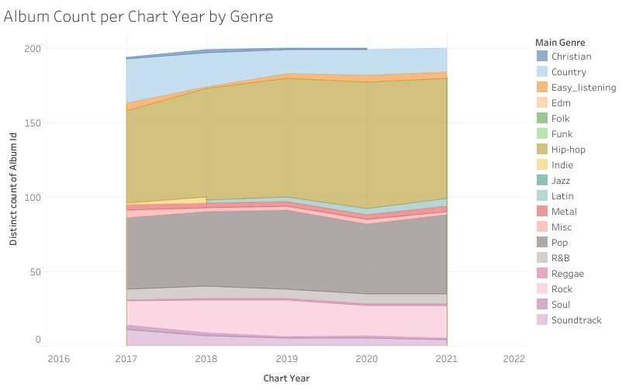
ALBUM COUNT PER CHART YEAR BY GENRE

Slide 37
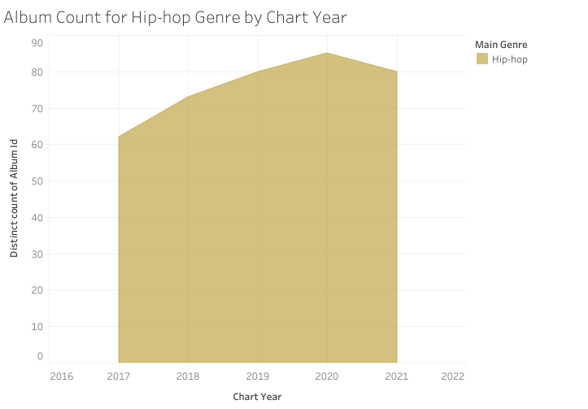
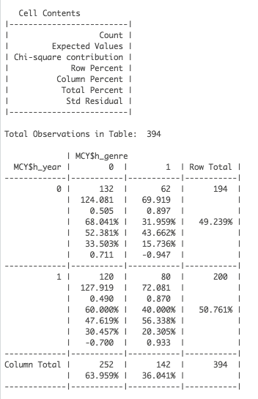
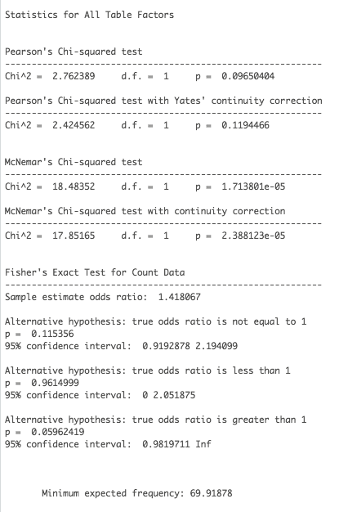
ALBUM COUNT PER CHART YEAR FOR HIP-HOP GENRE

Slide 38
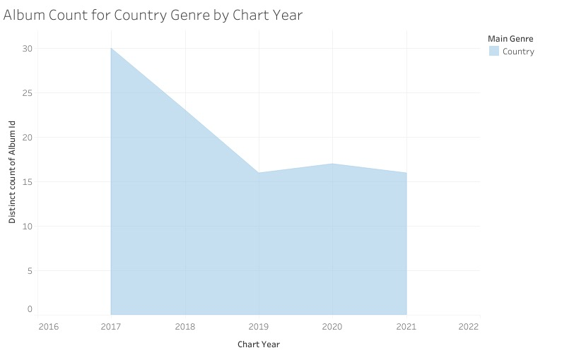
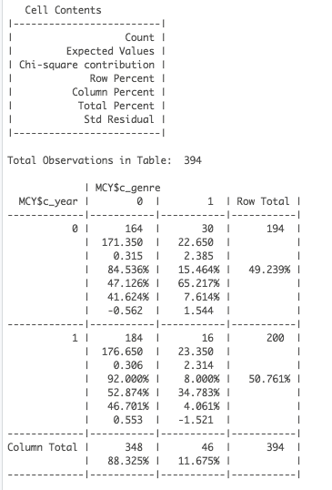
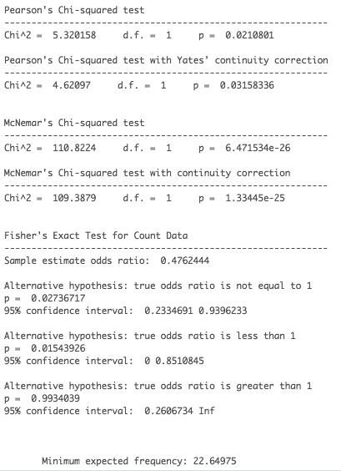
ALBUM COUNT PER CHART YEAR FOR COUNTRY GENRE

Slide 39
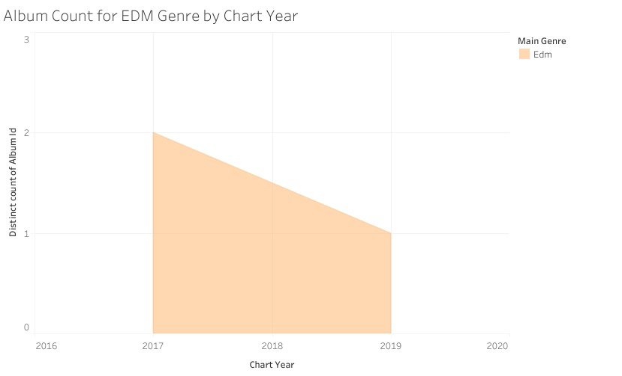
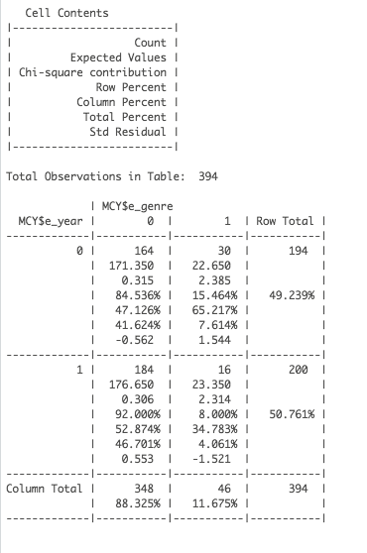
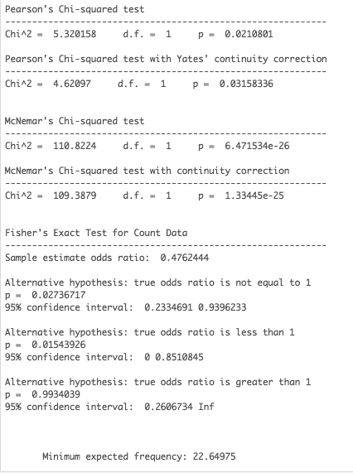
ALBUM COUNT PER CHART YEAR FOR EDM GENRE

Slide 40
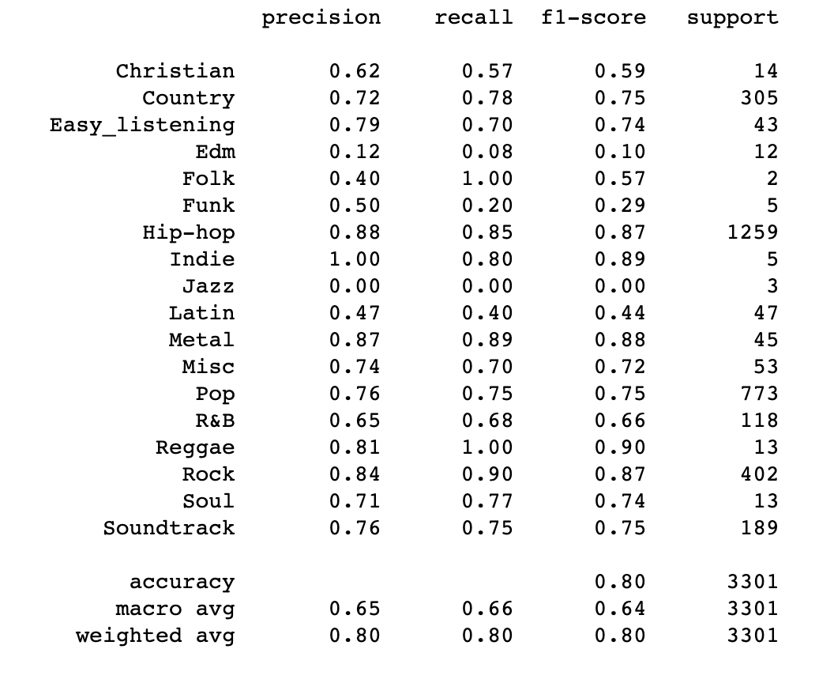
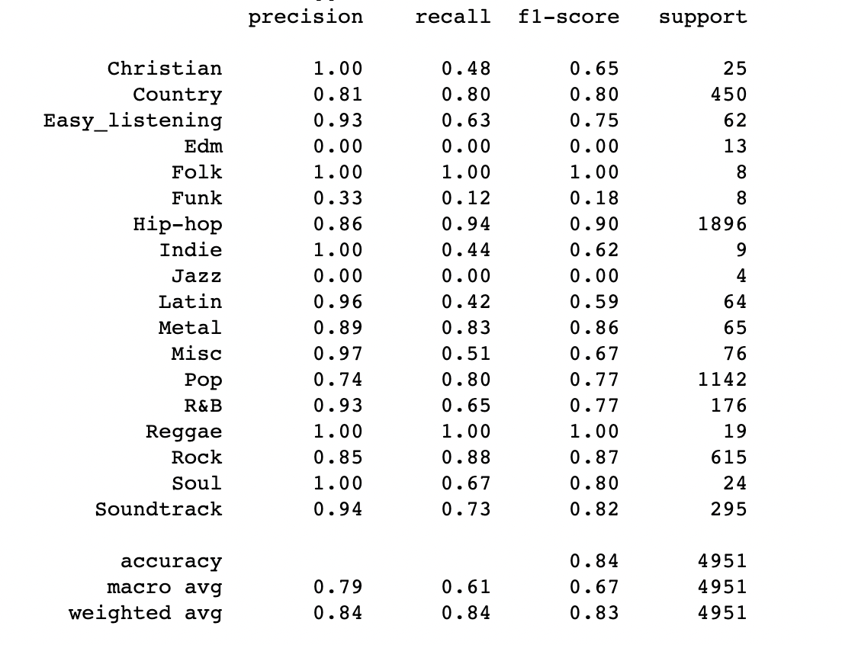

GENRE CLASSIFICATION
K Nearest Neighbors
Random Forest Classifier

Slide 41
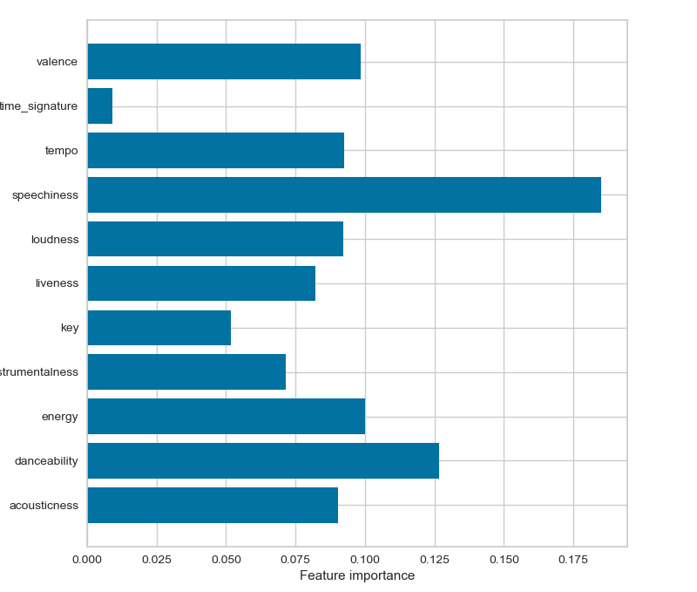
FEATURE INFLUENCE

Slide 42

SUMMARY

Slide 43
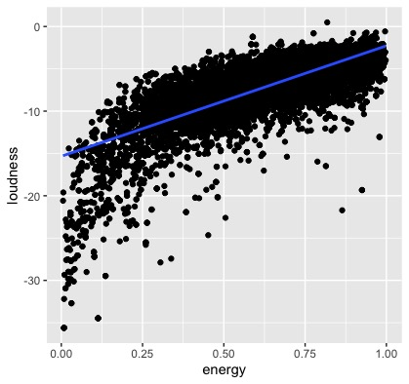
SUMMARY
GENRE PRESENCE
ENERGY CHANGE
Hip-hop presence on the charts increased while albums in the the Country genre decreased.
Average track energy decreased during the five-year analysis period.
CORRELATIONS
VALENCE CHANGE
Energy was significantly correlated with loudness and valence.
Valence generally increased during the five year analysis period, particularly in 2020.
Notes:
Read the slide

Slide 44

CONCLUSIONS

Slide 45
CONCLUSIONS
IMPORTANCE
IMPACT
Music is a vital part in the human experience and affects each person’s life in some way. The details within the music we love are worth exploring and learning about, and they help us find more music that resonates with us.
Analysis of music features helps entertainment, streaming, and social media companies find focus and gain insight on current musical trends. This allows the maximization of profits and revenue.

Slide 46
QUESTIONS

Slide 47

THANK YOU
FOR
LISTENING
More information and
analyses available
on our GitHub repo:
https://bit.ly/SxB5YA

